Slide 1




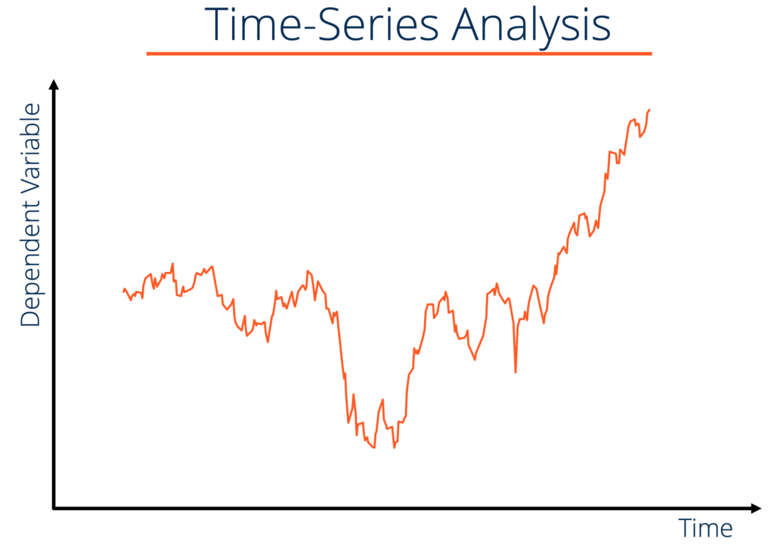
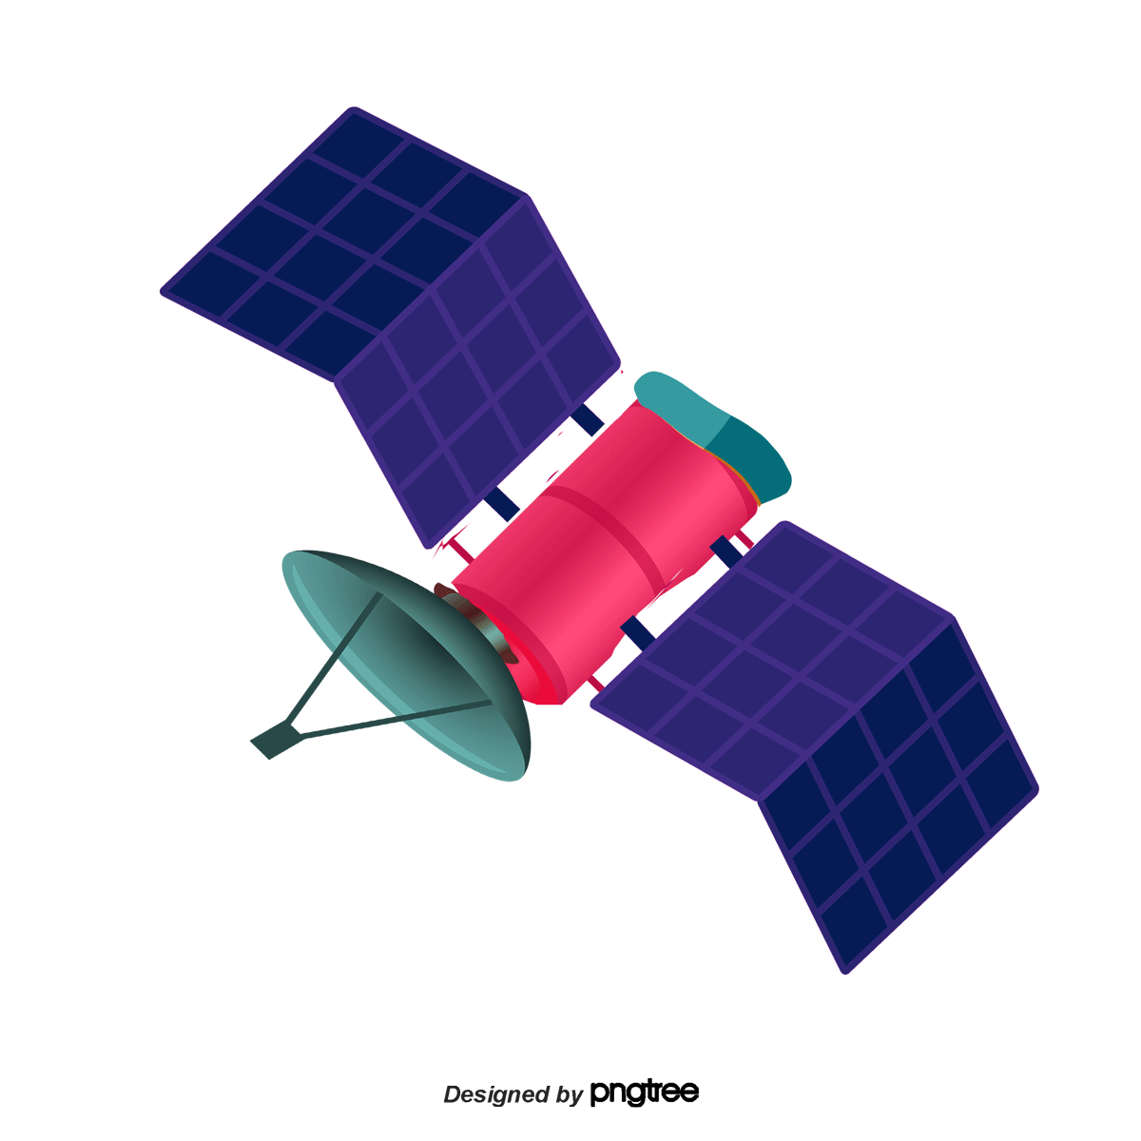
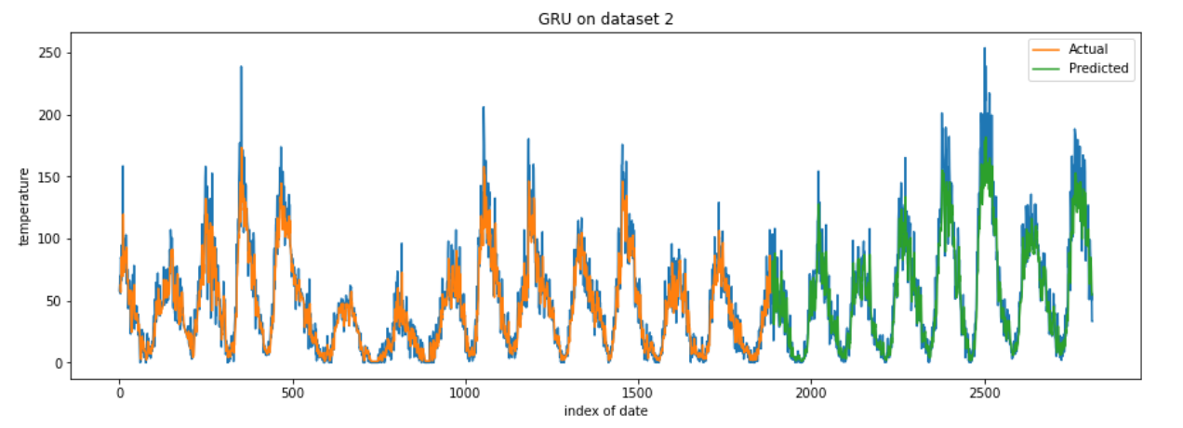
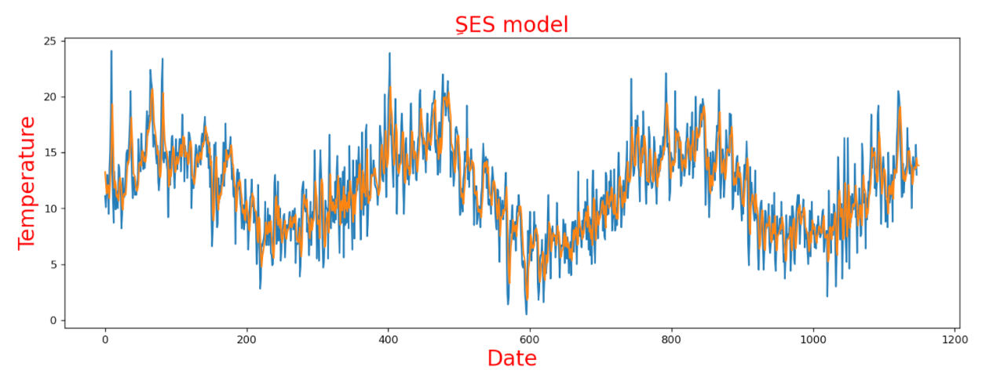
Egyptian Universities Training Satellite
Summer training 2021
Anomaly detection for satellite telemetry DATA
T42 - Computer and Artificial intelligence Helwan University
Introduction
What is Telemetry Data?
Dataset Description
What is Time Series?
Telemetry Definition:
Telemetry is the automated communication processes from multiple data sources. Telemetry data is used to improve customer experiences, monitor security, application health, quality, and performance.
Our Datasets consist of Two CSV file
- first file with Colum date and Temperature
- Second file with Two columns Date and Sunspots
A time series is a sequence of data points that occur in successive order over some period of time
It Include Analysis AS:
Time Series Analysis
Time Series Forecasting
Project Aim
Requirements and tools
The Project aim to analysis and predict Temperature data that come from satellite Over interval of time through various time series analysis Algorithms
For our work, our implementation language is Python 3
Using Library as:
Pandas Library For Data Manipulation Processing
NumPy Library For Array manipulation
Matplotlib Library For Data Visualization
Scikit-learn Library for calculate Mean square error between Actual and Predicted data
Statsmodels Library For ARIMA & ARMA
Our Work Done Under Jupiter environment
Working Plan and Algorithms Used
1-Data Preprocessing
GRU Algorithm
Our first step was Clean and Analysis datasets, In Cleaning data set we depends on Remove missing value from dataset and change data type for some columns in the data
Mean Square Error : 15.42
Algorithms used
ARIMA
ARMA
Simple Exponential Smoothing “SES”
Long Short Term Memory ‘LSTM’
XGBosst Regression
Gated recurrent Unit “GRU”
We used best Algorithms Model For Datasets to be shown:
Simple Exponential Smoothing
Mean Square Error : 2.56
Conclusion
The Team Behind this Work
- We learnt about time series data, data analysis and unsupervised machine learning models used on time series data for anomaly detection.
Best Algorithm that predict data based on mean square error
For Dataset 1 is :
For Dataset 2 is :
Prepared By:
- Yousef Khaled
- Mohmmed Ramzi
- Mohmmed Maher
- Yousef Medhat
- Mustafa Mahmoud
- Mohamed Anas
University :
Helwan University
Supervisor :
Eng. Ahmed Salama

